Slide 2
Rapid IDP Capability Development
Jesse Sanford & Greg Haynes
Autodesk
Notes:
Hi everyone, welcome to our talk about rapid internal developer platform development.
This topic has a lot of interest right now and we’re excited to share some practices and open source tools to help accelerate development of your platform

Slide 3


About Us
Jesse Sanford
Software Architect, Autodesk
Greg Haynes
Software Architect, Autodesk
Notes:
But first, we’d like to introduce ourselves, starting with Jesse
<Jesse Intro>
<Greg Intro>

Slide 4
What is this talk about?
Why we need a reference Cloud-Native developer platform
How we created our reference platform
(and open sourced it!)
How to super-charge your Internal Developer Platform creation.
Notes:
So what are we here to talk about?
First, I’m going to start out with the “Why” and hopefully I can convince you, based on our own experience, of the value in creating tooling to build reference internal dev platforms.
After some of that history and context, we’ll start to talk about the tools we created – and open sourced - to help accelerate our development.
We’ll also be sharing links to all the demo code in this presentation at the end.
And finally, Jesse has some awesome demonstrations for how you can use these tools to increase your idp development velocity

Slide 5




How it started
In-House Dev. Platform
Notes:
So how did we get here?
For quite a while now, our internal developer platform at Autodesk has been built around Jenkins, spinnaker and a lot of in-house tooling and configuration for these tools.
This is a common, albeit somewhat legacy dev platform architecture, and along with many other organization with similar dev platforms we are facing major challenges in scaling to meet the needs of our users.
These problems mostly relate to poor velocity and low confidence in shipping changes to our developer platform, as well as an inability to own more of the deployment process as the platform team.

Slide 6
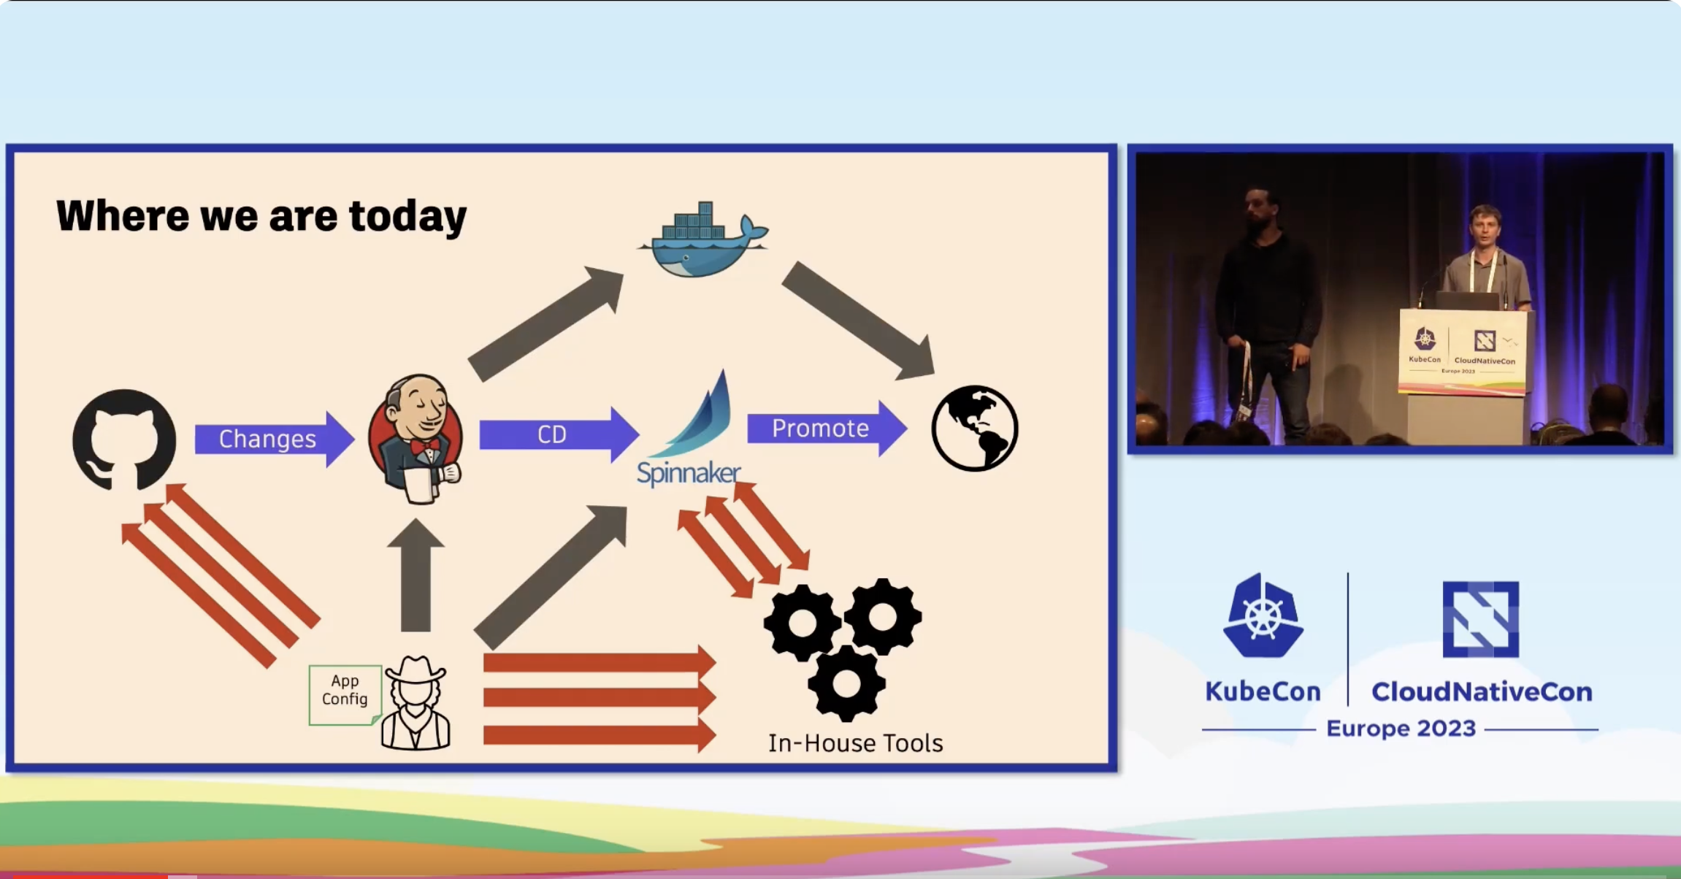

How it started
In-House Dev. Platform
Notes:
I’m going to briefly talk about what problems we set out to solve with our new developer platform but I wont be going in to too much detail as this was the focus of a talk we gave last year at Kubecon.
but if youre interested, heres a QR code to that talk. I highly recommend checking it out, especially if youre not clear on the issues associated with a tightly coupled deployment system like this.

Slide 7




How it started
In-House Dev. Platform
Notes:
In short, we realized we had significantly drifted from the norm for cloud-native developer tools which was making it much more expensive to solve these issues.
At the same time, we are a large organization, and therefore we need to make some long term investments to ensure we can scale development of our platform.
We decided that our new developer platform would double-down on GitOps and Kubernetes buy leveraging Kubernetes controllers to expose all sorts of functionality.
By doing this, we can increasingly leverage standard tooling like ArgoCD and Backstage without writing one-off integrations for different pieces of functionality.

Slide 8

Kubecon EU 2023
Cloud-Native Dev. Platform
Notes:
And that’s where we found ourselves about a year ago – we were building out this new platform and migrating pieces of functionality to it.
It also turned out that we were right about many of the wins
Feature development was much quicker and teams could work independently but leverage one another via the Kubernetes Resource Model.
Significantly more validation was also possible for our changes helping to increase confidence as we released them
Most of all, though – we were closer to the norm allowing us to increasingly leverage these leading open source technologies
So then why are we back?

Slide 9
Kubecon EU 2023
Notes:
It turned out this transition had some very interesting challenges.
The main one being that the reality looks more like this.
Its hard to make a single developer platform, and its far too easy to build a collection of independent product areas with limited interoperability
This is a real shame, because as platform technologies this truly is a case where the sum is more than its parts, and much of the real value we are after are workflows that span all of these systems
We can expose CRDs via Kubernetes for all sorts of functionality, but without ArgoCD powering our GitOps workflows, or Backstage making them discoverable and easy to use they dont huge impact for our users.

Slide 10

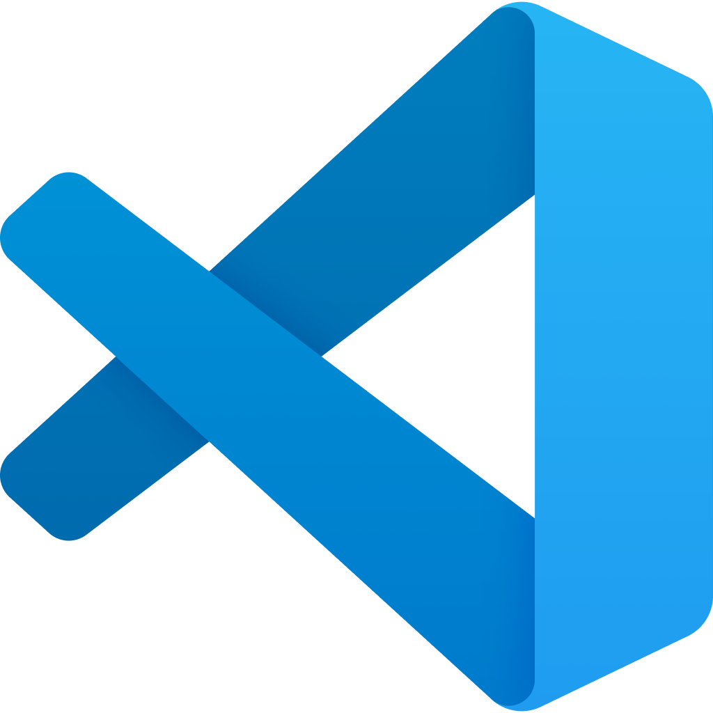
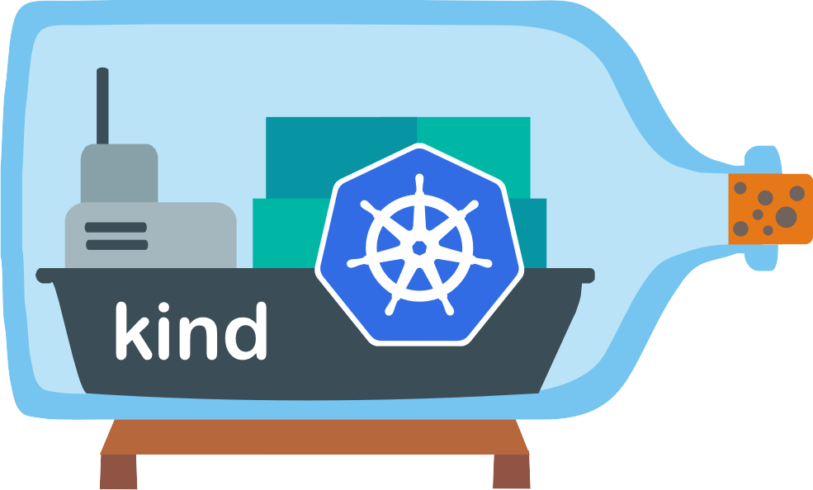

Platform Feature Dev/Deploy
Develop
CI
CD
Notes:
Why is this such a problem that we felt the need to make a Kubecon talk about it?
The problem lies in what is needed to enable these teams to all work together to make a cohesive developer platform.
We might envision a world like this – where we have a set of technologies for powering our dev platform which are all shared among our dev/deploy processes
but we found that this is actually very challenging to implement
So we built some tools to make it easier!

Slide 11


Platform Feature Dev/Deploy
Develop
CI
Notes:
Lets walk through an example
Imagine – you have a developer portal team which is well experienced in nodejs development and they need need to add support for change deployment and promotion to the dev portal.
You’re follow typical GitOps practices, so this involves integrating with ArgoCD

Slide 12
Platform Feature Dev/Deploy
Develop
CI
Notes:
Now, you also want to show the status/health of these deployments, and this means integrating with Kubernetes too.

Slide 13
Platform Feature Dev/Deploy
Develop
CI
Notes:
I also forgot, you make use of crossplane and custom Kubernetes operators, so we’re pulling them in as well.

Slide 14
Platform Feature Dev/Deploy
Develop
CI
Develop
CI
Notes:
But think about what your dev/CI process looks like for your Kubernetes deployment platform.
I’m willing to bet it looks significantly different than your node js app development process, and there in lies one of the major challenges.
So now youre asking your developer portal team to set up the dev environment for your deployment platform and then perform this integration themselves before they can even start.
Even worse – your CI pipelines for both of these are independent so even after your heroic dev portal team builds these integrations how are you going to validate them continuously?
While this may seem contrived – this type of separation, in my experience, kills your dev platforms quality and velocity.

Slide 15
Platform Feature Dev/Deploy
Notes:
Not only is this a problem from an engineering point of view
in order to build a cohesive internal developer platform and get the valuable connected workflows we are after, we need all our designers, pms, and architects speaking a common language
I went to a great talk yesterday about Kubernetes sig-architecture and one thing they mentioned is how their goal is to counter act the silo’s created by teams working within their scope of control
This is exactly what we are after here – its important that these teams can all work quickly and independently, but they also need to work toward developing a single platform.
What we have found is that without a simple way for all the teams to use, experience, and develop on the cohesive platform this shared vision is hard to develop.
This is what we are after with our reference platform.
The bundling of these technologies together so they seem like a single, cohesive platform

Slide 16
Controller Dev/Deploy
Notes:
So how can we solve this?
First, we’re not the only team making internal developer portals and not all will be the same.
So we need to make some lowest common denominator assumptions.
For now, that’s Kubernetes and ArgoCD.

Slide 17

Controller Dev/Deploy
Notes:
With this, we devised a way to package together an argo application with its resources in a redistributable manner

Slide 18

Controller Dev/Deploy
spec:
source:
repoURL: cnoe://manifests
Inspired by ko.build!
Notes:
We’ve done this by taking inspiration from one of my personal favorite tools which I don’t think gets enough love – ko.build.
Quick aside – if your org is getting in to platform development using Kubernetes controllers I highly recommend checking this project out. See that qr code in the corner
Back on topic.
We’ve written tooling which allows us to refer to a set of resources in the same directory as an argo application and deploy them as a single package.
With this we are now able to create redistributable, locally deployable and testable packages powered by our base platform tooling.

Slide 19
Controller Dev/Deploy
Notes:
This is what we use to package up our developer platform tools like backstage, custom operators, and off the shelf controllers like crossplane.
Most importantly though – now we’re able to have all our teams work on their packages but in an environment where they are part of the whole developer platform, not just their domain.

Slide 20

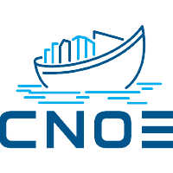
Controller Dev/Deploy
https://github.com/cnoe-io/idpbuilder
Notes:
Lastly, I want to mention that we didn’t do this alone.
Early on we started an open source working group called CNOE.
This working group has developed tooling we call idpbuilder to implement this design and which will be the focus of Jesse’s demonstration
Participating in this open source community has been the most impactful decision we’ve made throughout this project
Much of this development was performed by external contributors and these tools have become much more mature than they could have with only us as the developers.

Slide 21
Notes:
Thanks Greg!
So Interaction time to see who’s awake!
How many of you have passed your CKAD EXAM?
CAN I SEE A SHOW OF HANDS?
How many of you attempted but didn’t’ pass yet?
Don’t be embarrassed it’s an achievement…
I haven’t passed mine!

Slide 22

If you couldn’t tell this content was AI generated and has nothing to do with our employers.
Notes:
How many of you think CKAD MEANS
COOL KITTEN ALIGATOR DOCTORS LIKE MY DAUGHTERS?

Slide 23
Notes:
Sorry Girls as much as I wish it was …. that’s not it!

Slide 24
Demo!
What you are about to see:
Standing up a default idpbuilder cluster
Installing a custom CNOE “package"
Creating a Kubebuilder based operator and publishing locally
Backstage template generation from a CRD w/ local publishing
Using new template to create k8s resources
Notes:
So let’s say you are a certified kubernetes developer and you are writing custom controllers and extending the kube api
How are you running your code locally?
Are you standing up minikube?
Are you using ephemeral cloud environments?
What about all the supporting resources? Are you using infra as code or config management tooling?
Now how are you getting that environment setup for QA?
Or on your coworkers workstation?

Slide 25
Demo!
What you are about to see:
Standing up a default idpbuilder cluster
Installing a custom CNOE “package"
Creating a Kubebuilder based operator and publishing locally
Backstage template generation from a CRD w/ local publishing
Using new template to create k8s resources
Notes:
What about backstage developers?
Do you run everything locally?
What about different architectures?
What about those just getting started with either of those ecosystems?
They are diverse! There is a ton of content!
Where do you get started building modern platform engineering tooling?
The project we are about to showcase and the CNOE group aim to help with that.
Let’s take a look!

Slide 26
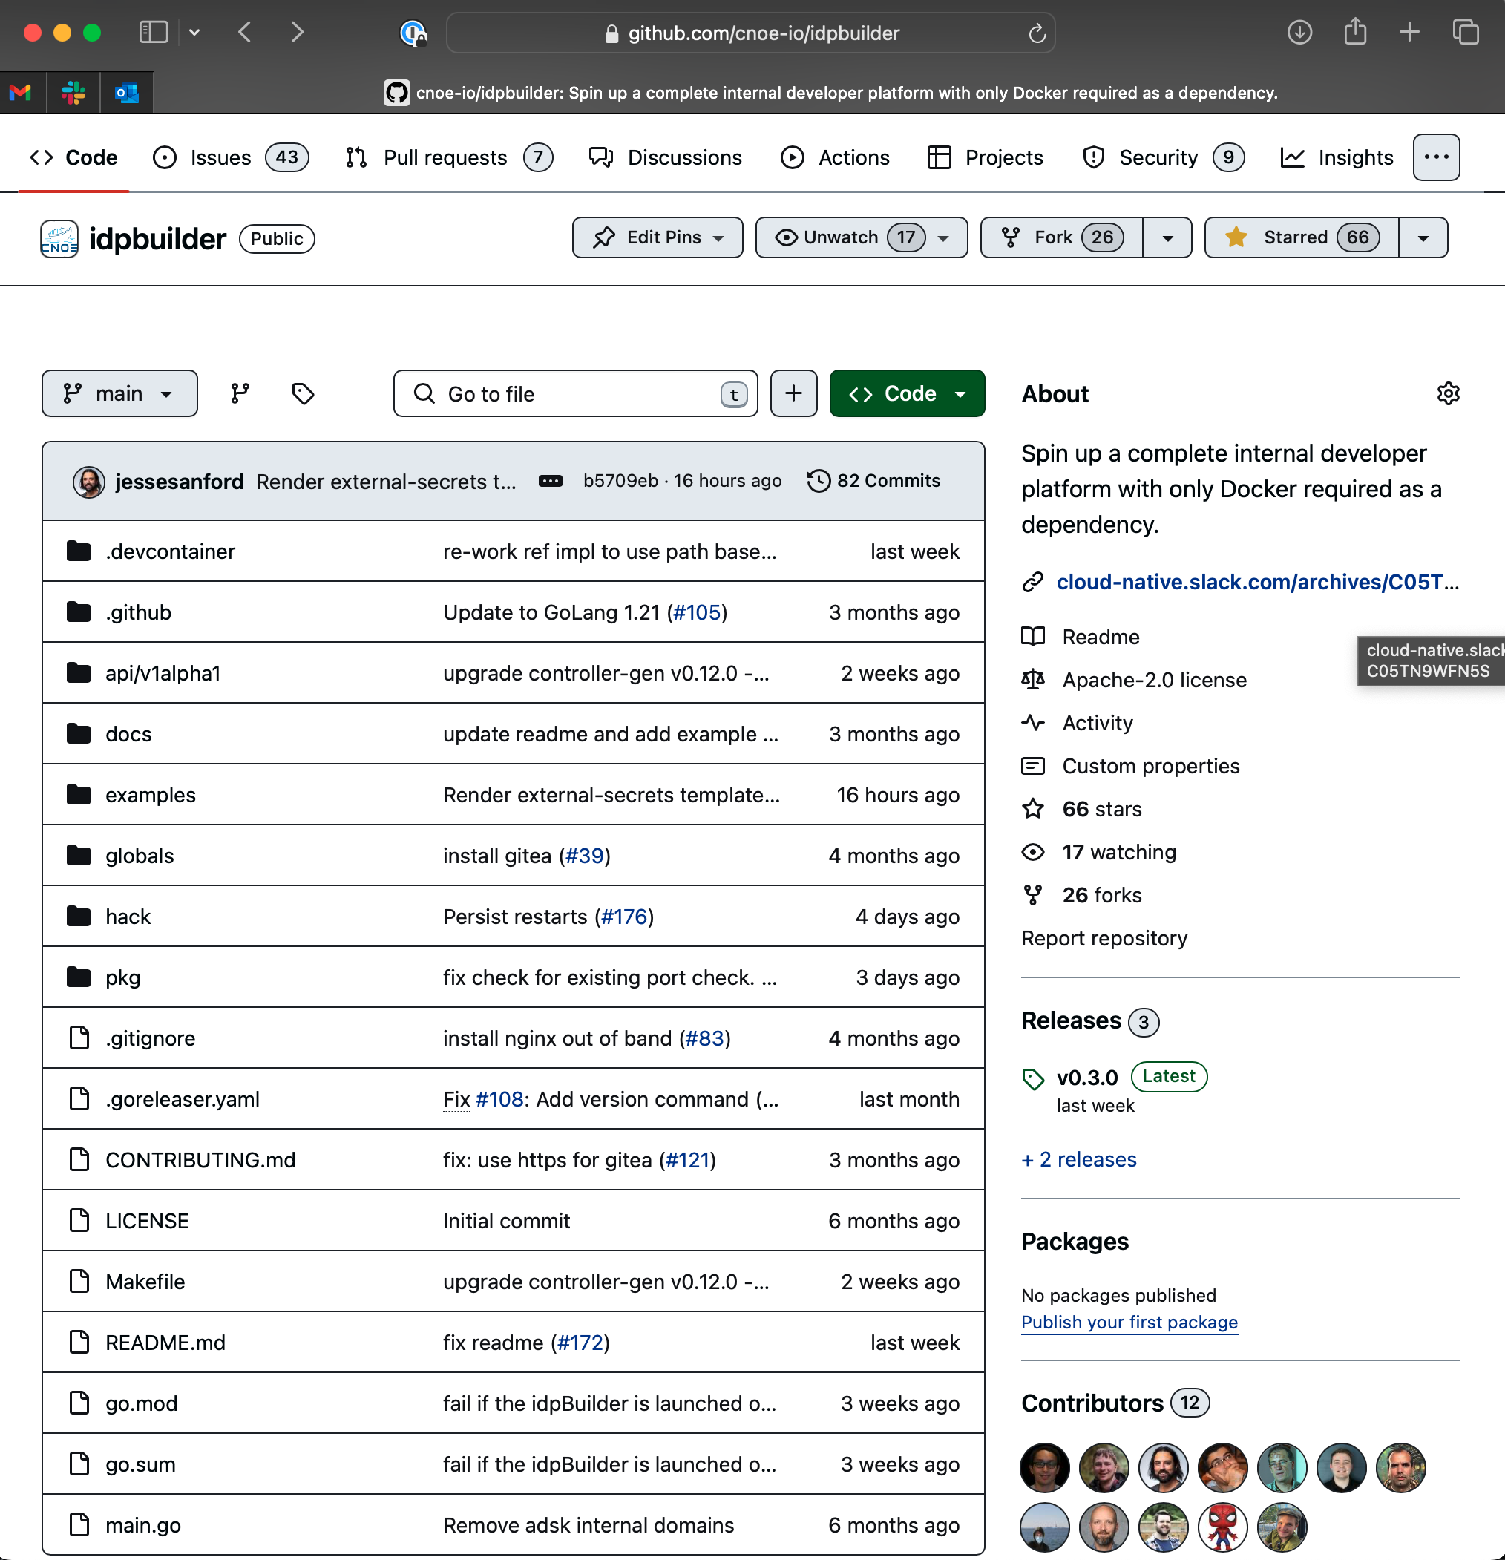
https://github.com/cnoe-io/idpbuilder
Notes:
Yes we have a project repo
Look we have stars!

Slide 27

HINT HINT
Notes:
We could use more!!! Hint hint!

Slide 28
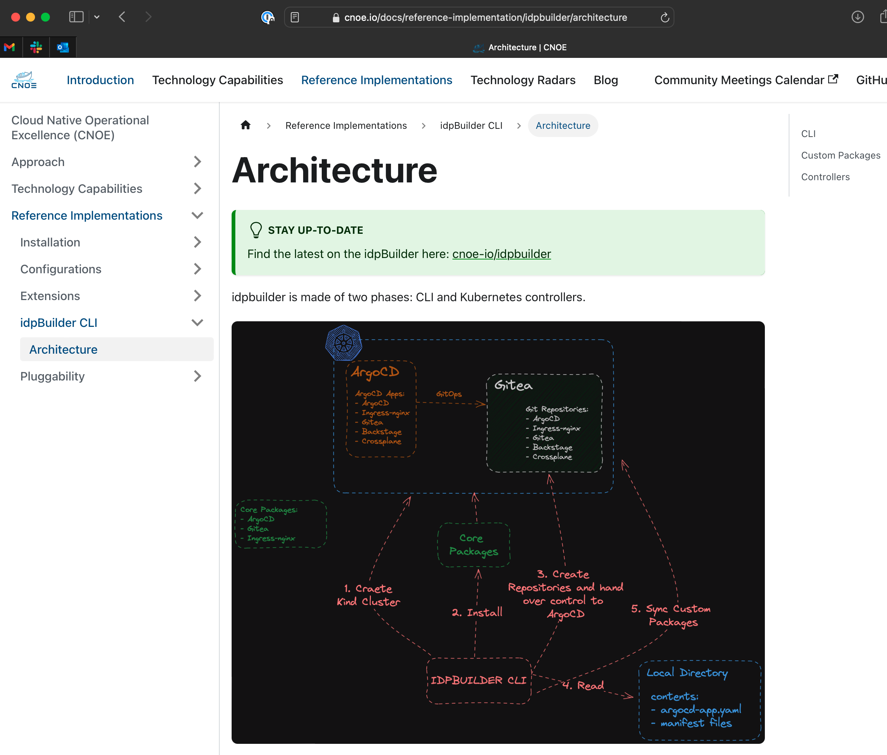

https://cnoe.io
Notes:
We also have docs!
They could be better!

Slide 29
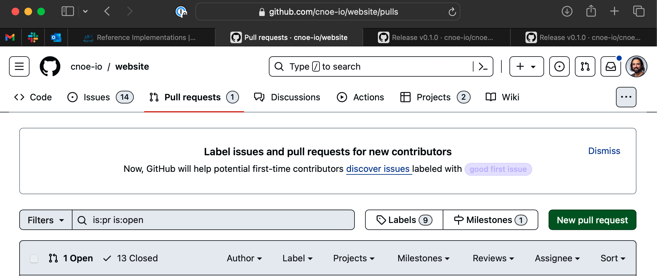
AGAIN HINT!
Notes:
We accept PRs
Again hint!

Slide 30
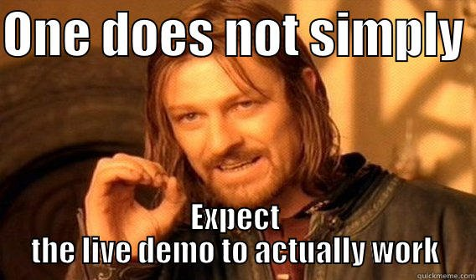

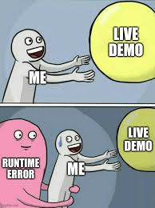

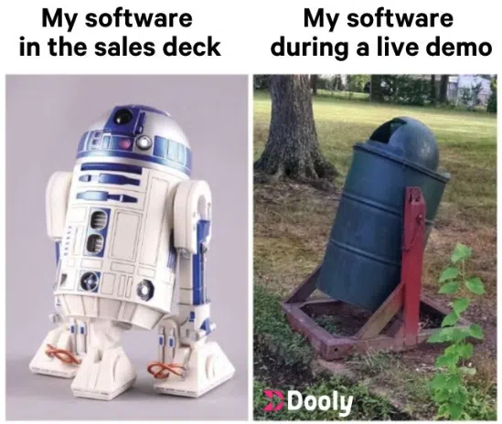
Live Demo?!

Slide 31

Live Demo?

Slide 32
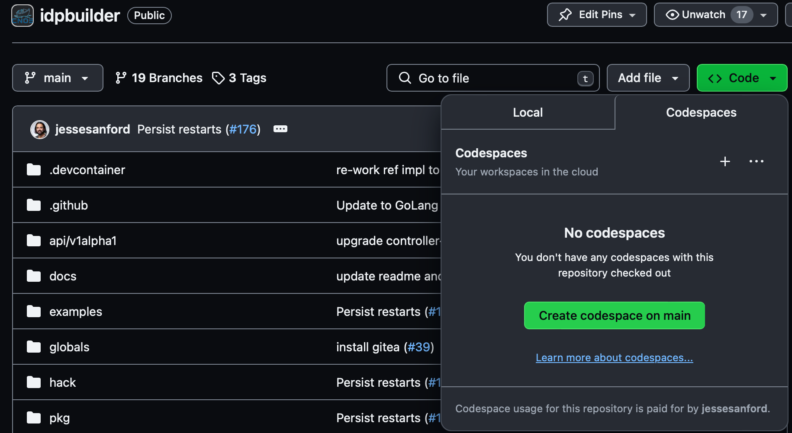
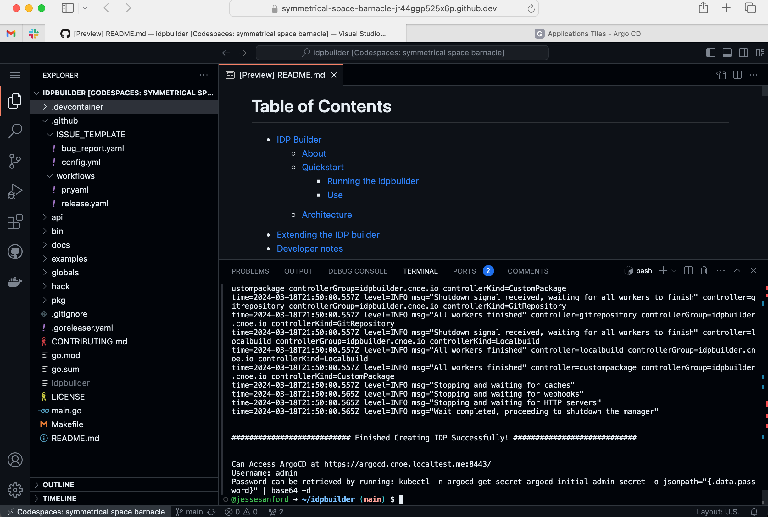
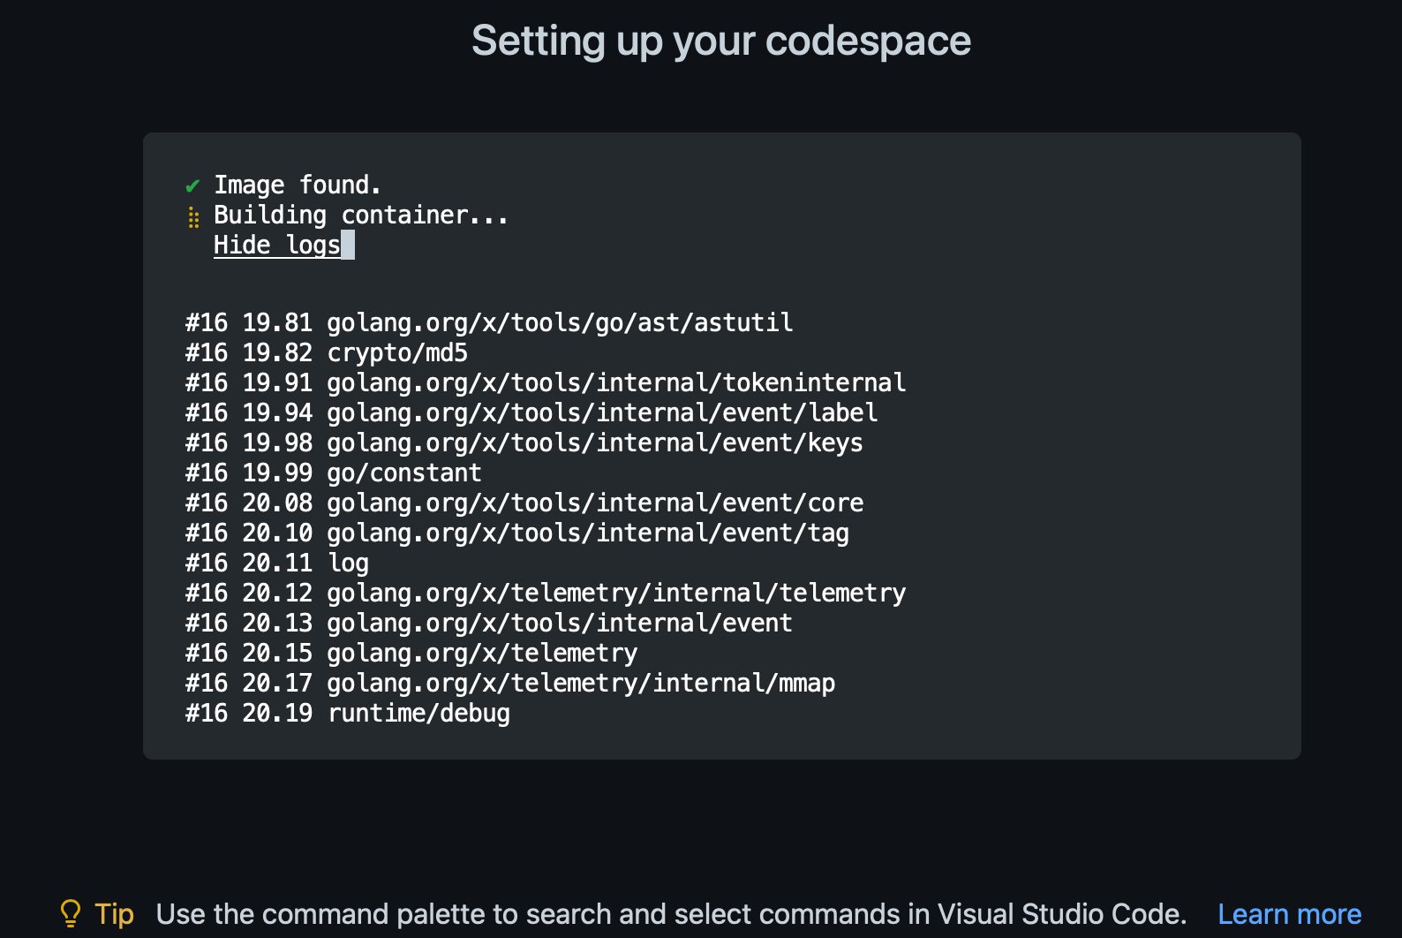
Try it on Codespaces!
Credit: Carlos Santana (csantanapr) & Manabu McCloskey (nabuskey)

Slide 33
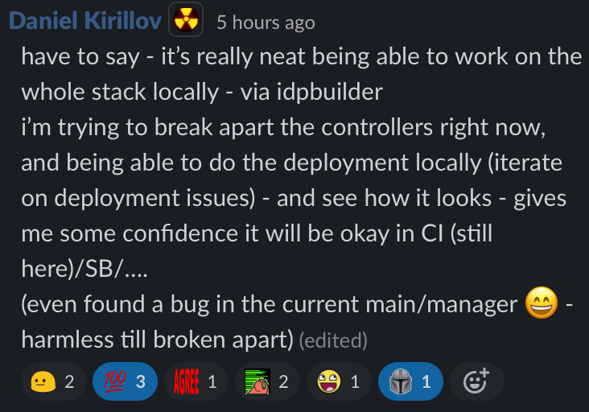
Testimony
...I think it's pretty awesome that the whole reference implementation could run on a Raspberry Pi
Also in a vscode remote dev container... Kind of impressive to me. –Arron Atchison

Slide 34
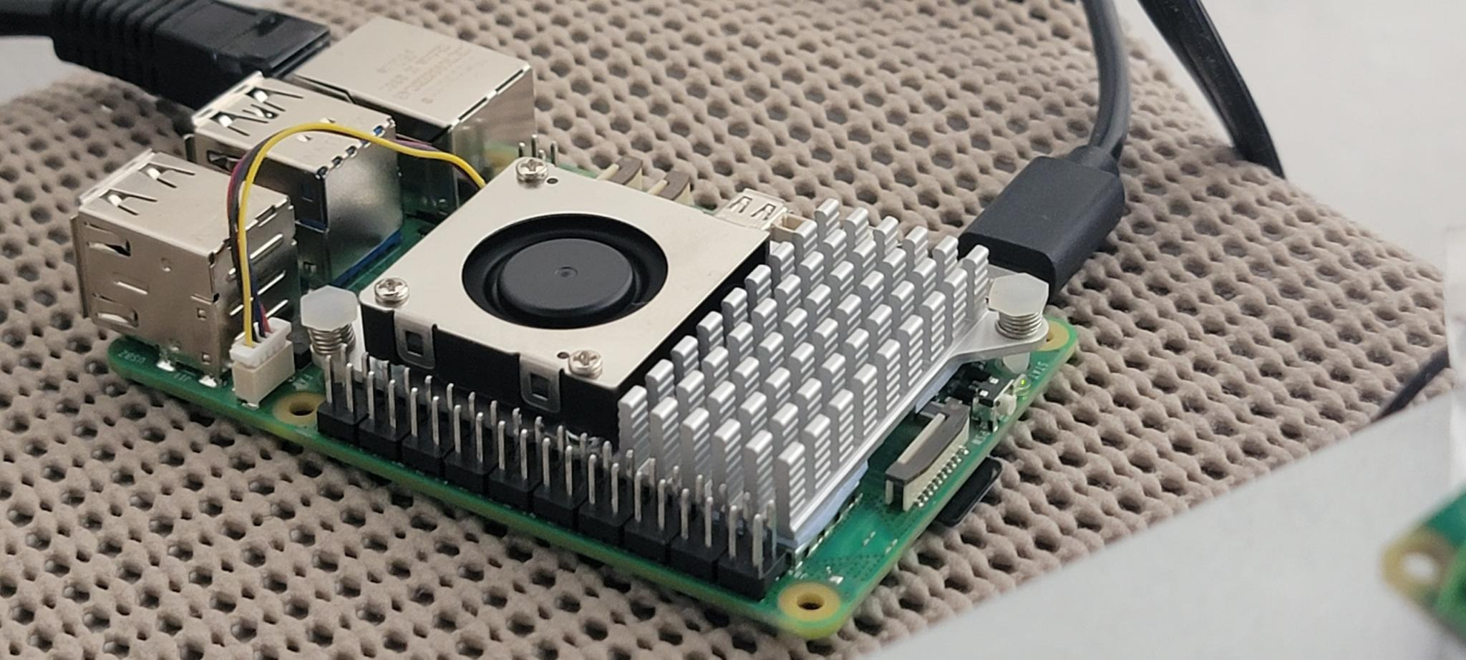
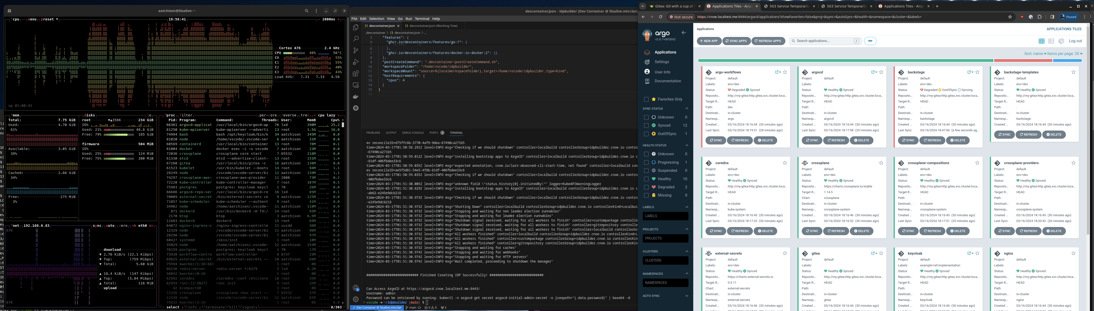
One more thing!
Credit: Arron Atchison

Slide 35
Thanks
Thanks to everyone who helped get idpbuilder over the line!
MVP to Manabu McCloskey!
Big thanks to Charles Moulliard!
Nima Kaviani and the rest of the CNOE core team!
https://github.com/cnoe-io/idpbuilder
https://cnoe.io

